Slide 1
intel’s makers community ESP32 for advanced makers
Gil Tal.
Sep 2022

Slide 2
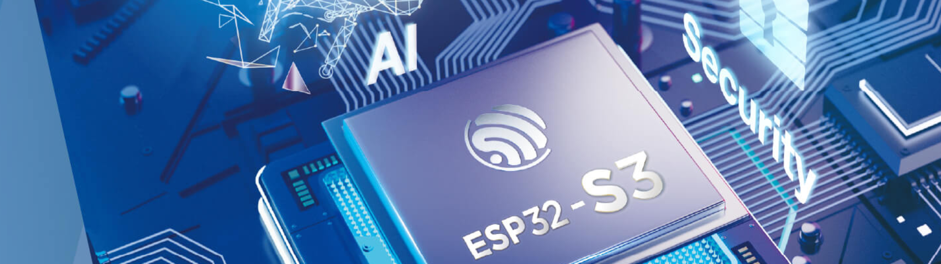
My targets for this course
Takes us few steps upwards from the standard Arduino
Get to know the ESP32 micro controllers' family and their great features

Slide 3
Agenda
What is the ESP32 (main features)
The ESP32 family of devices
Cool projects
Device driver
Communication protocols
Advanced topics (Dual CPU – Multi Tasks, Queues)
EEPROM and file system
OTA (Over The Air update)
Useful information

Slide 4
What is an ESP32?
Highly advanced micro controller
Targeted at IOT
Supported by Arduino SDK
Low cost (2.5$ - 4$)
WiFi and Bluetooth

Slide 5
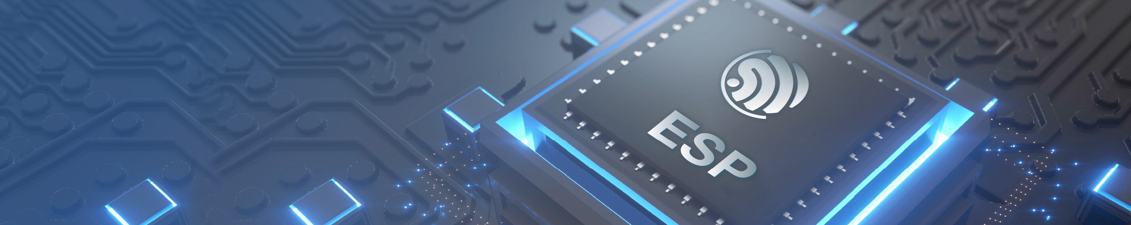
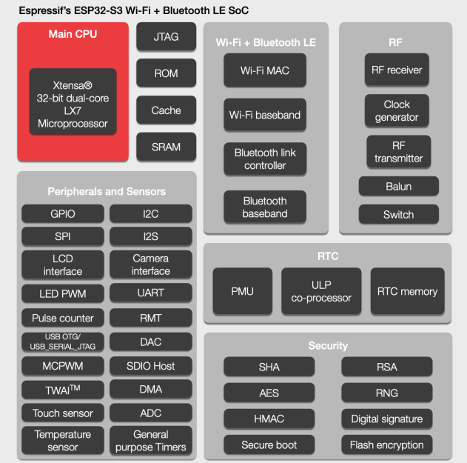
Main features …
Dual-core XTensa LX7 @ 240 MHz
Wi-Fi + Bluetooth 5 (LE)
Rich Set of IO Peripherals
SPI, I2C, I2S, Camera, LCD, 45 IOs, SD
Ultra-low-power (ULP) core
FreeRTOS OS
Multi tasks, Queues
AI Acceleration Support
OTA
File System + EEPROM
384KB SRAM , up to 8MB SPI-RAM, up to 32MB flash memory (Programs + file system)
Touch sensor pins

Slide 6
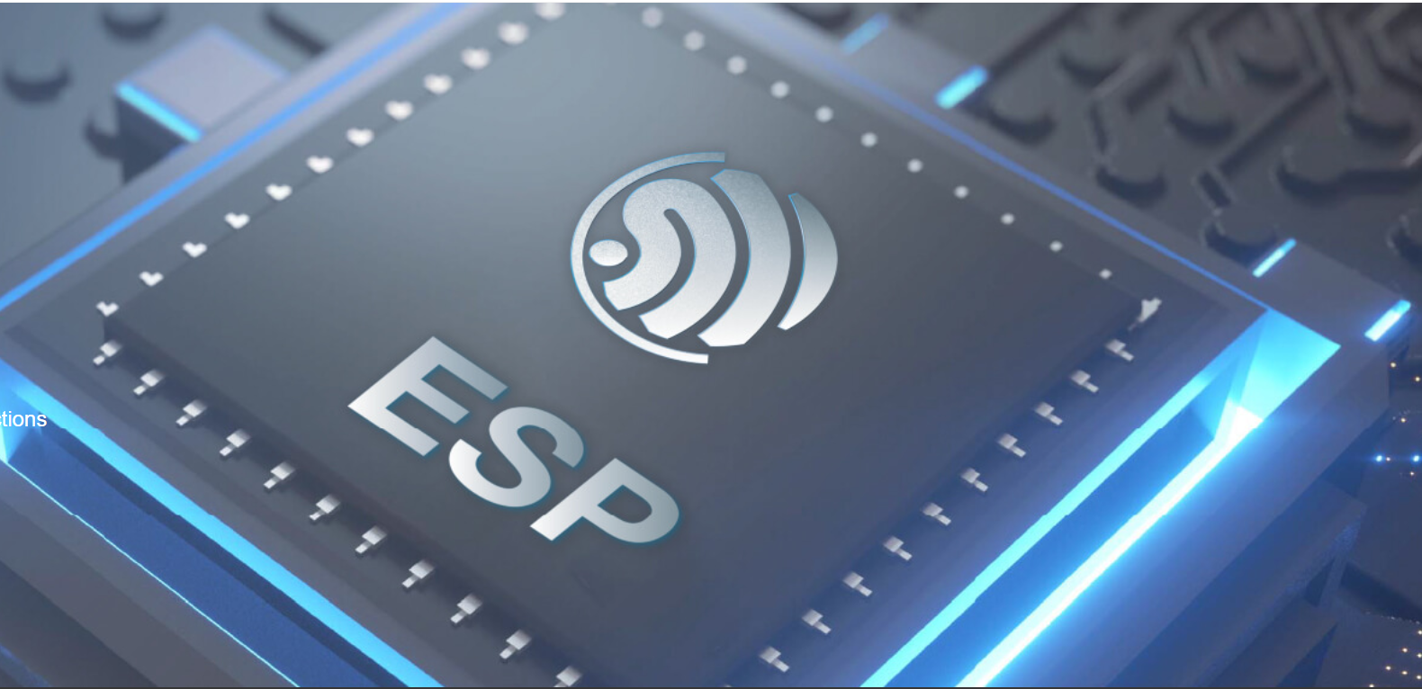
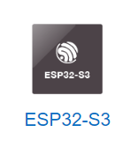
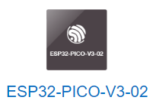
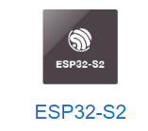
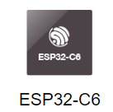
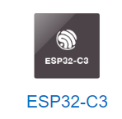
The whole family

Slide 7

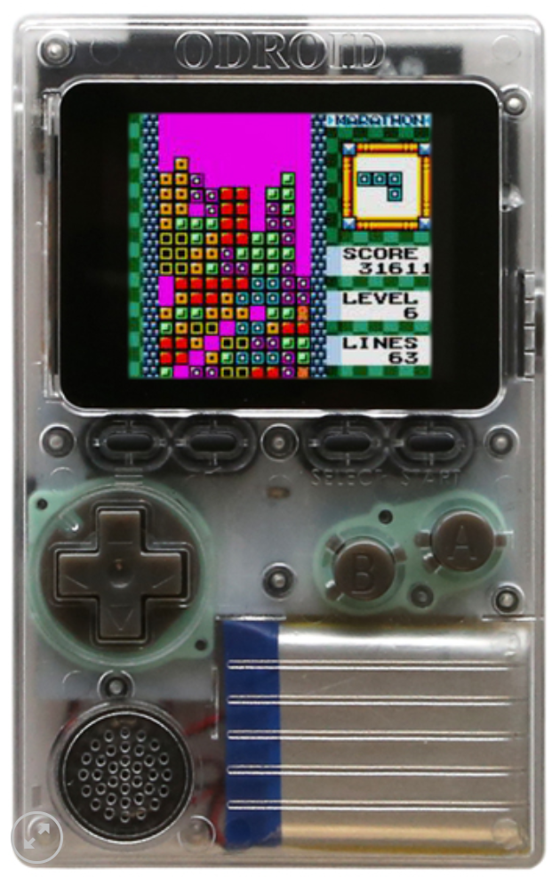
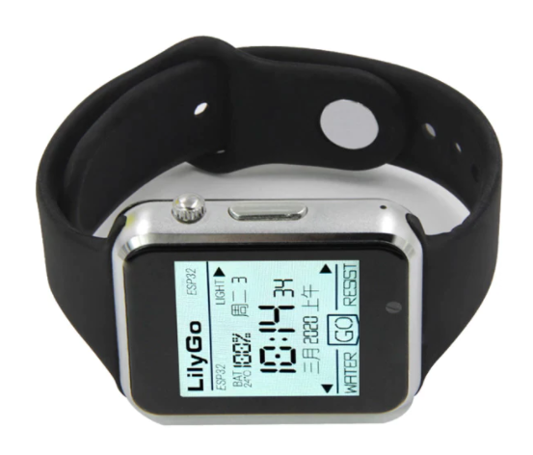
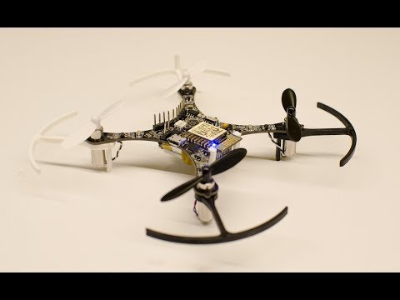
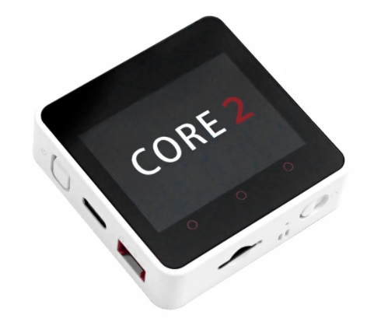
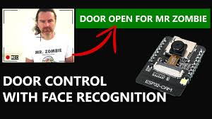
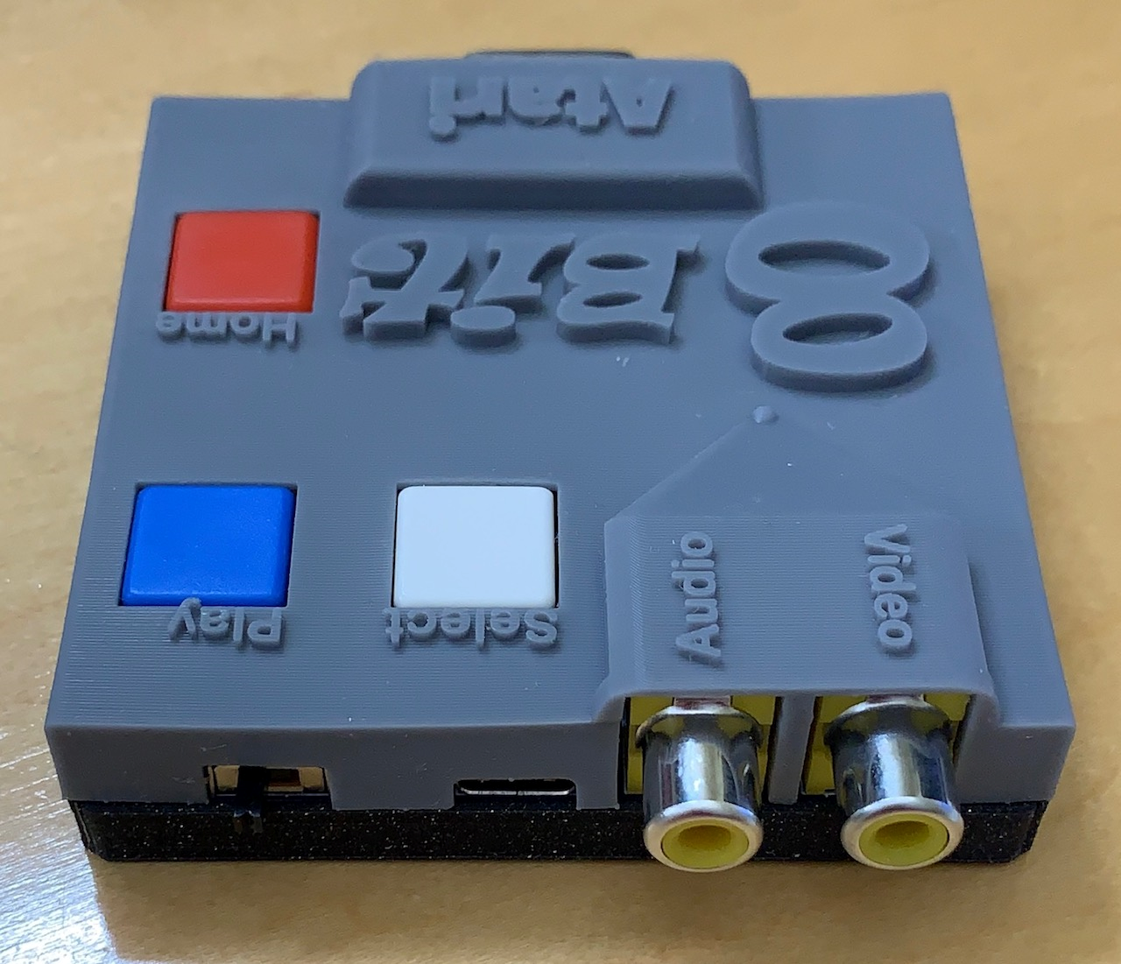
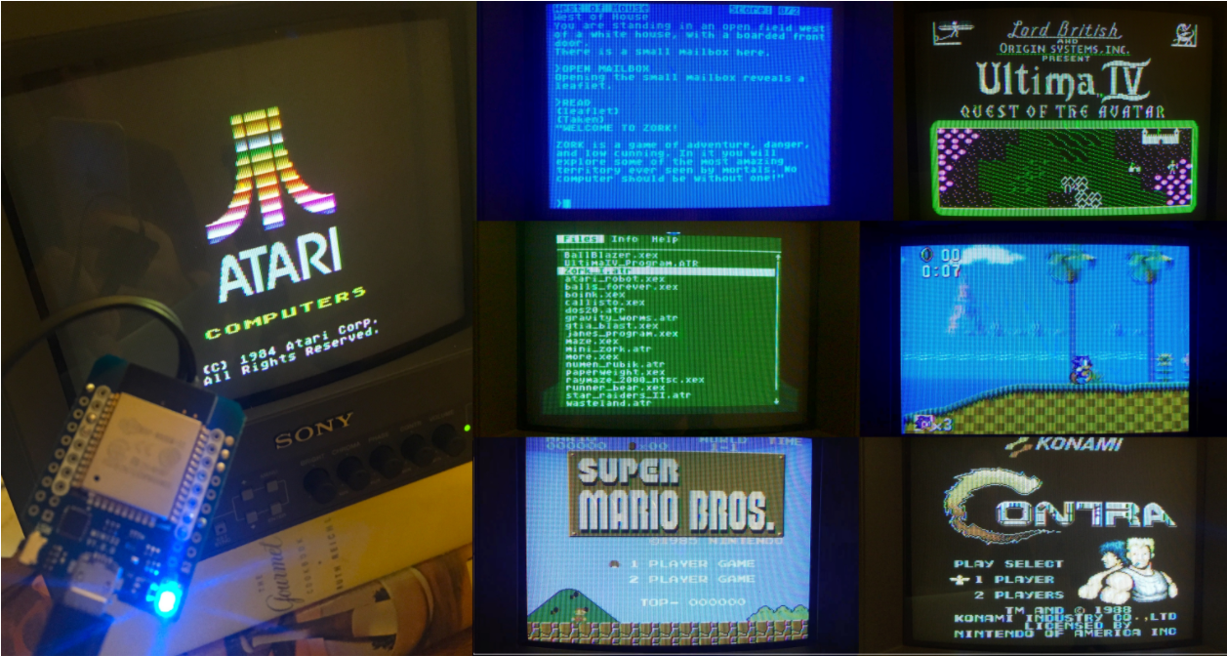
Some cool projects

Slide 8
Device driver
Device Driver
Micro Controller
(ESP32)
Enable us to:
Utilize the device’s capabilities
Initialize the device
Device
(LCD for Example)
Device Driver
SW structure
HAL
Hardware Abstraction Layer
User API
Application Programming Interface

Slide 9
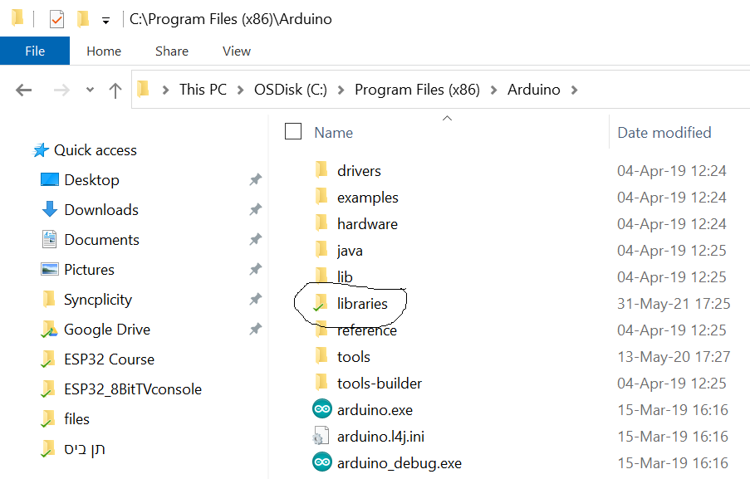
Getting started with a driver
When using a driver for the first time:
We need to place the driver in the library Arduino folder
We might need to do a small porting or adaptations
Types of adaptions we might face:
The simplest one is just providing basic parameters such as:
I\O pins mapping
I2C address
Unit index (in case we have multiple instances of the same unit)
Next will need a background task or an interrupt service routine
In most cases an example is provided
A More complicated one will need an accessor - meaning:
We will need to inherent a C++ class and link\implement HAL functions
I will go through an example

Slide 10
HAL \ API
HAL (direct HW access):
Used by the driver internally
SPI interface native functions for example
SPI.writeBYTE((char)VAL);
ESP_WRITE_REG(0x3FF4400c, PAR_IOs_MASK);
API (To be used by the programmer ☺):
Graphics driver functions for examples:
fillScr(unsigned char r, unsigned char g, unsigned char b);
drawRoundRect(short x1, short y1, short x2, short y2, bool fill = false);

Slide 11
Communication options
Legacy
WiFi
Using Web Server (Access via Phone, Tablet and any devices with a web browser)
ESPnow
Over cloud services
MQTT
Bluetooth
LoRa
IOs (Digital and Analog)
UART, SPI, I2C

Slide 12
Basic communication protocols
Devices can be connected physically by copper wires or over the air (Wi-Fi, Bluetooth, RF, WEB)
There are various communication protocols, some are standard, and some are unique
Simple protocols: (Low to medium speed and bandwidth)
I2C (Two wires – data and clock) (100 or 400 KHz) – can serve many devices concurrently
UART (RS232) (9600 up to 921000 bps) – only one device per interface
SPI - Serial Peripheral Interface (1 – 166 MHz (DDR), data width 1 up to 8 bits) – can serve many devices concurrently
RF (LoRa and more)
Advanced protocols (Medium to very high speed and bandwidth)
Bluetooth
Wi-Fi: Ethernet – TFTP, UDP,WEB
PCIe (Gen 4 runs at 16GHz 16 bit width)
USB2\3\4 (up to 40GHz)
Thunderbolt (up to 40GHz)

Slide 13
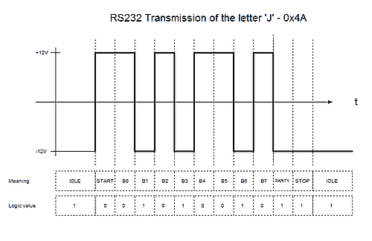
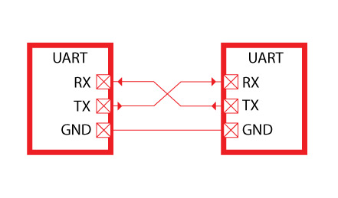
RS232 - UART
Was born in 1960
In the basic mode uses two signals: RX and TX (Receive and Transmit)
Works at speeds from 4800 (bits per second) up to 921000 (usually 115200 is being used)
Both transmitter and receiver must be set at the same baud rate
Works at various voltages (although the standard is +/- 12V)
Used by most of the micro controllers as the main communication port
Today mostly used using USB to UART device (FTDI)

Slide 14
Configuration of RS232
Both sides must be set with the same configuration and voltage level*
BAUD rate (speed – 9600, 115200 or any other supported speed)
Use parity bit or not (in most cases not used)
Number of stop bits: 1 or 2 (in most cases 1 stop bit)

Slide 15
End to end example

Slide 16

I2C Protocol (Inter-Integrated Circuit)
Defined by Philips for variety of simple devices such as
EEPROM, Cameras, simple LCDs, modems, I/O expanders and more
Each family of devices has a unique address prefix (There are some out of spec devices ☹)
Very low speed bus: 100 – 400 KHz (new devices might support 1 M\bit)
Two signals only: SCL (Clock), SDL (Data)
No chip select, address selectable devices (7 or 10 bit)
Bus topology: meaning many devices can be connected to the same master
Open drain I/O (Must have pull up resistors, usually 4.7K)
Master and slave methodology (Only master can initiate a transaction)
Some device has fixed 4-6 address bits and the rest can be set on board

Slide 17
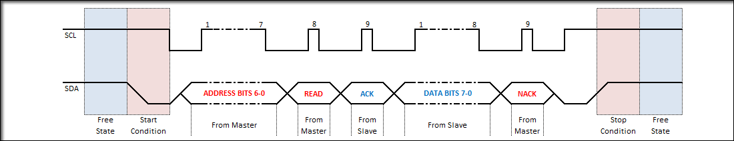
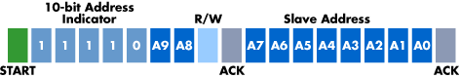
I2C wave form
Master
SCL
SDA
Slave 1
Address: 0x20
Slave 1
Address: 0x38

Slide 18
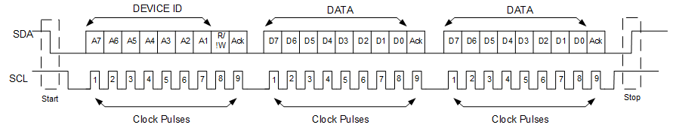
I2C multiple Read\Write
No stop bit

Slide 19
I2C Code example
Wire.begin(-1/*Native SCL Pin*/, -1/* Native SDA Pin*/, 100000);
// Read
Wire.requestFrom(address,(uint8_t)1/*Size*/);
if(Wire.available()) // If bytes are available to be received
{
byte dataIn = Wire.read();
}
// Write
Wire.beginTransmission(address);
Wire.write(data);
Wire.endTransmission();

Slide 20
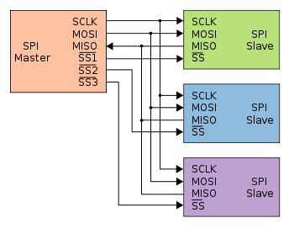
SPI - Serial Peripheral Interface
Much higher performance than UART or I2C
1 bit data (MOSI, MISO, CLOCK, CS)
Master Out Slave In
Master In Slave Out
4 or 8 bits data (CLOCK, CS, bi-directional D0-D7)
Bus topology – using chip select to address a specific device
Master and slave methodology
Up to 166MHz (DDR)
Mostly used for flash memories, SD cards, simple LCDs, LoRa transmitters and more

Slide 21
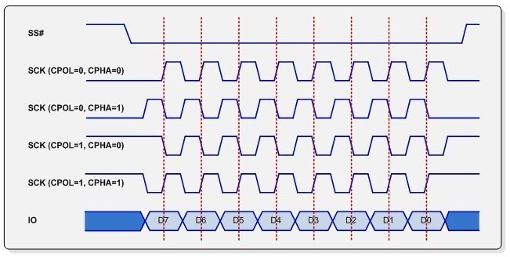
SPI Working modes
SPI mode | Clock polarity (CPOL/CKP) | Clock phase (CPHA)
0 | 0 | 0
1 | 0 | 1
2 | 1 | 0
3 | 1 | 1
CPOL - Clock polarity
CPHA - Clock phase
Meant for better timing setup

Slide 22
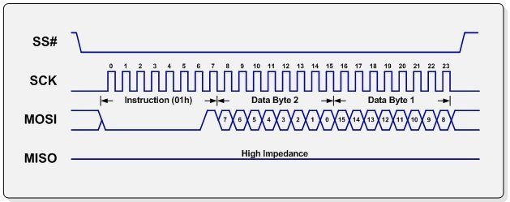
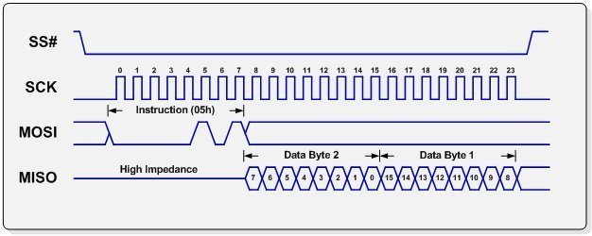
Read\Write (From flash memory) – 1 bit
Dummy cycles
Are optional

Slide 23
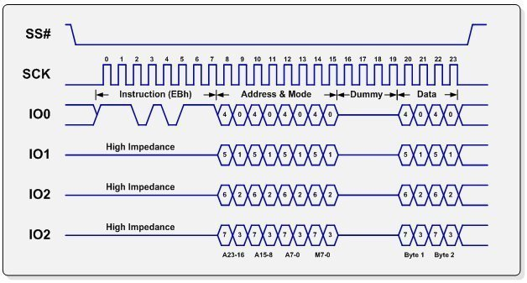
Read\Write (From flash memory) – 4 bit
Dummy cycles to enable
I/O direction change

Slide 24
ESP32’s Communication ports units
3 UARTs (first is the main and used for communication with the user and uploading code)
Up to 1 MHz
Can be mapped on almost any I/O
3 SPI (first used for main flash and PSRAM and is 4 bit wide)
Up to 80 MHz
1 Bit wide
Can be mapped on almost any I/O
One I2C
I2S – Audio dedicated protocol
Also used along with GPIO and DAC to generate very interesting projects

Slide 25
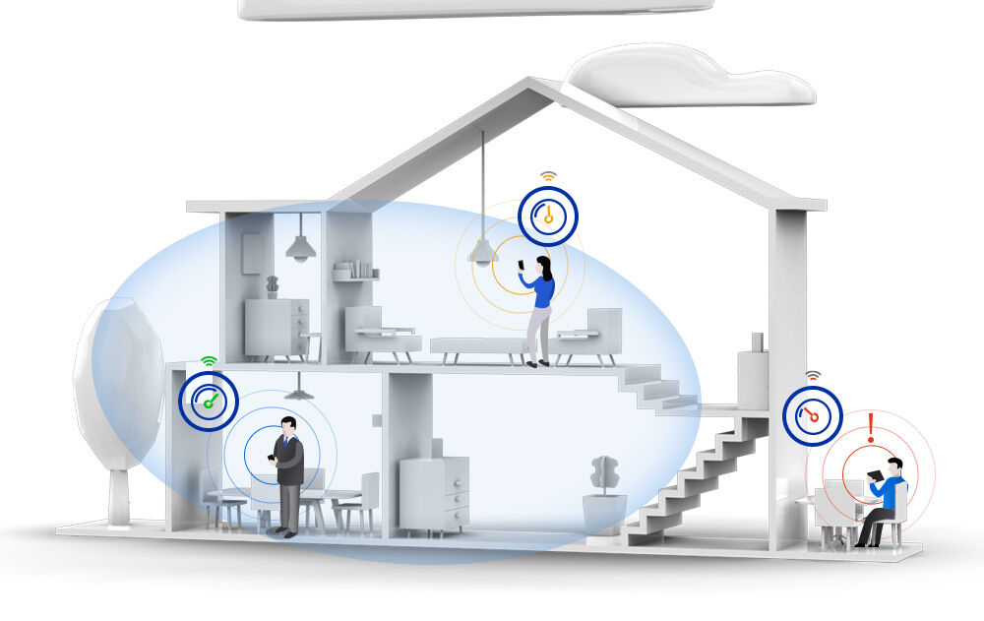
Wi-fi basics
Wi-Fi basics:
Family of wireless networking technologies
IEEE 802.11 family of standards
Used for local area networking of devices and Internet access
20-150 meters range
Standard defines 16 channels for communication
Enables multiple access points at the same physical location

Slide 26
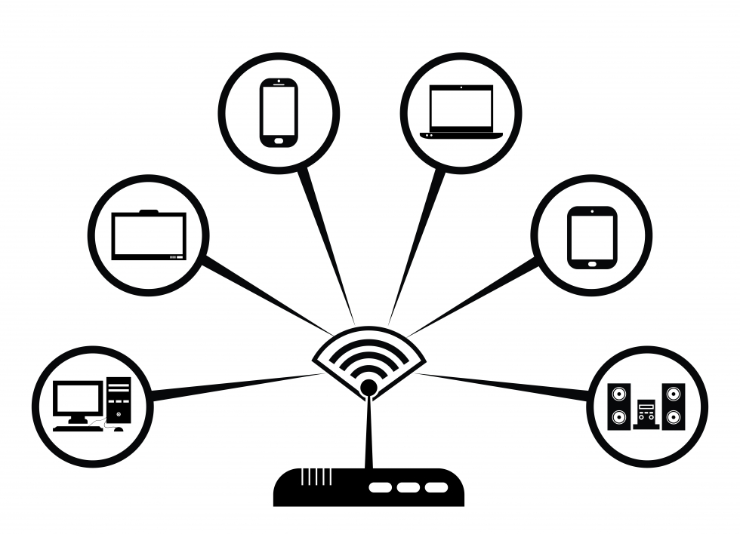
Communication options
AP – Access point
STA – Station
An end point device
Enable the creation of a local Wi-Fi network
We connect to access point
With or without access to the internet
Uses a specific channel which can be modified while operating
Has limitation for number of connected devices
Has a name and an optional password
Can use an encrypted communication protocol
Connects to an AP
While searching for an AP needs to scan different channels until found
Station name and password can be saved on EEPROM, SPIFFS or SDCARD
End Point device
AP

Slide 27
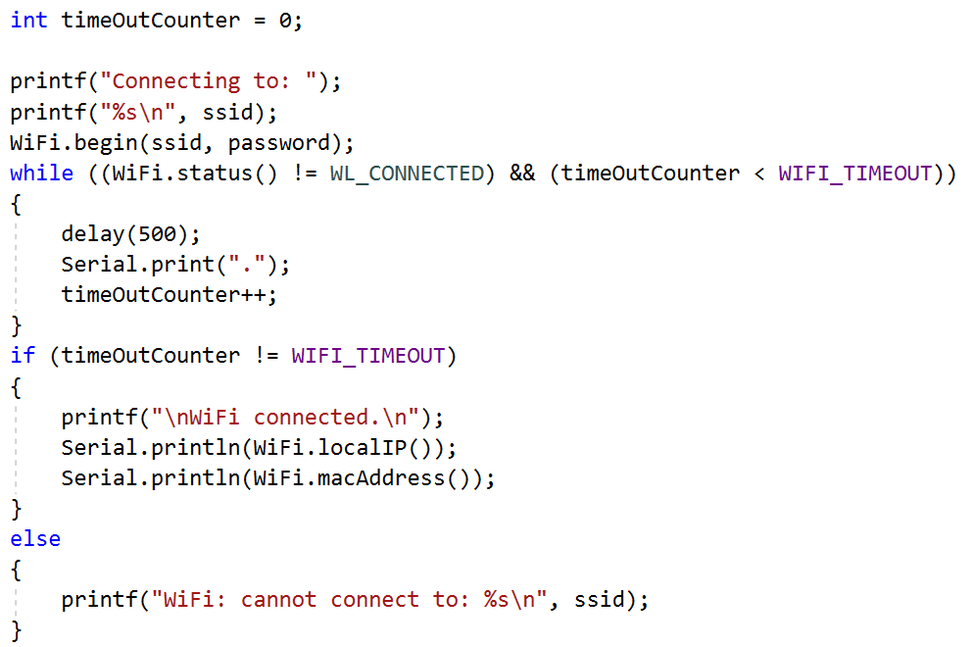
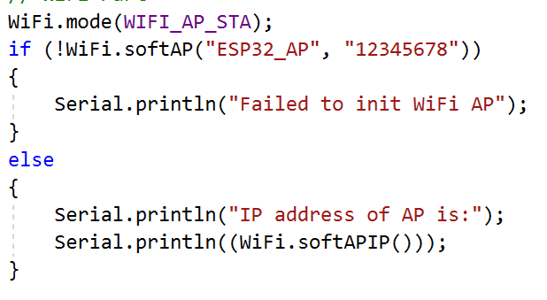
Wi-fi basics: our esp32
Runs full network stack
Can function as:
AP
By default, enables up to 4 users
STA
Both*

Slide 28
HTML
Hyper Text Markup Language
Is the standard markup language for documents designed to be displayed in a web browser
It can be assisted by technologies such as Cascading Style Sheets (CSS) and scripting languages such as JavaScript
https://www.w3schools.com/ - great site for learning and designing web pages

Slide 29
webserver
Web pages are hosted on a webserver
Most commonly written in HTML5 + JAVA script
There are various HTML5 emulators out there
Has a specific IP address (192.168.14.1 for example)
Is a passive device
We need a browser to access it
Browser is executing the HTML5 code
The communication protocol is HTTP
There are large number of hosting providers
IP address can be replaced by a name
DNS server translates the name to the specific IP address
ESP32 can run a webserver! ☺

Slide 30
Webserver – what can we do with it?
Have
a nice GUI to communicate with the ESP32 using a browser
Control
IOs
Get
information from our ESP32
Such as temperature, humidity depending on what we connected
Send
data to the ESP32
Files
Raw data

Slide 31
Webserver – workflow
We need to initialize:
WiFi
Webserver
Prepare the HTML for the pages
Handle the client which interacts with the browser
Process the incoming data from the browser to perform actions on the ESP

Slide 32
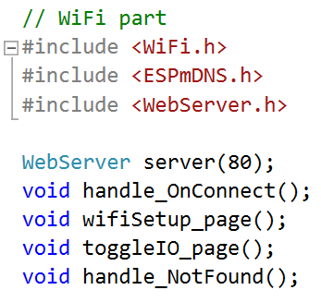
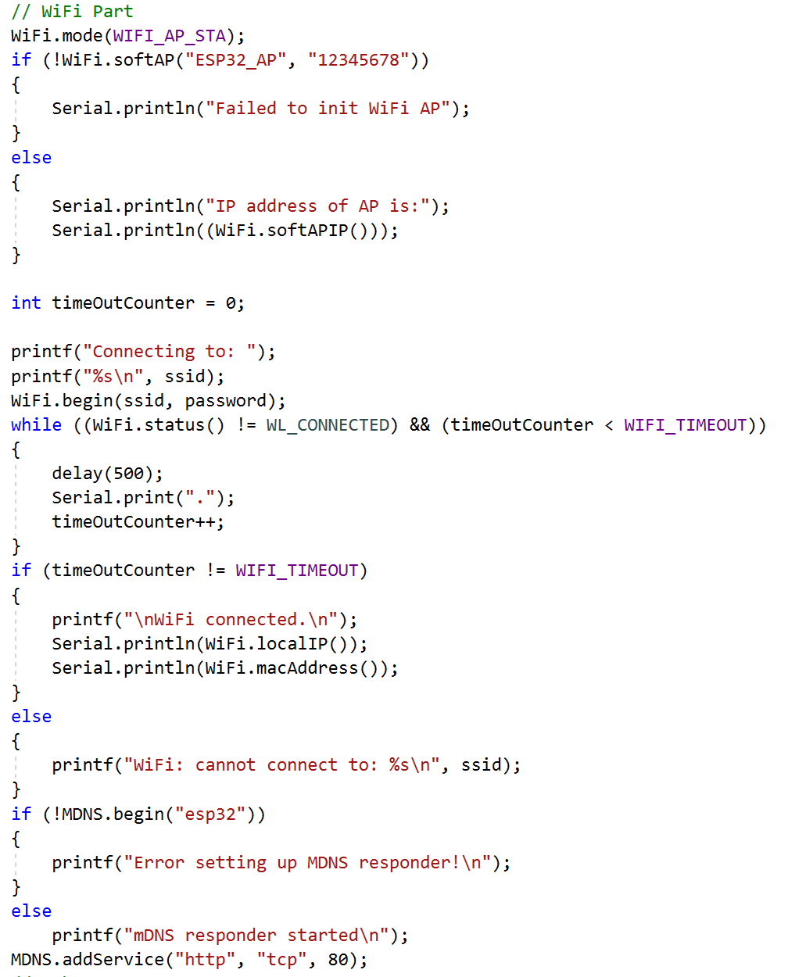
Webserver – Init code

Slide 33
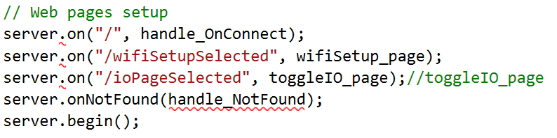
Webserver – INIT code

Slide 34
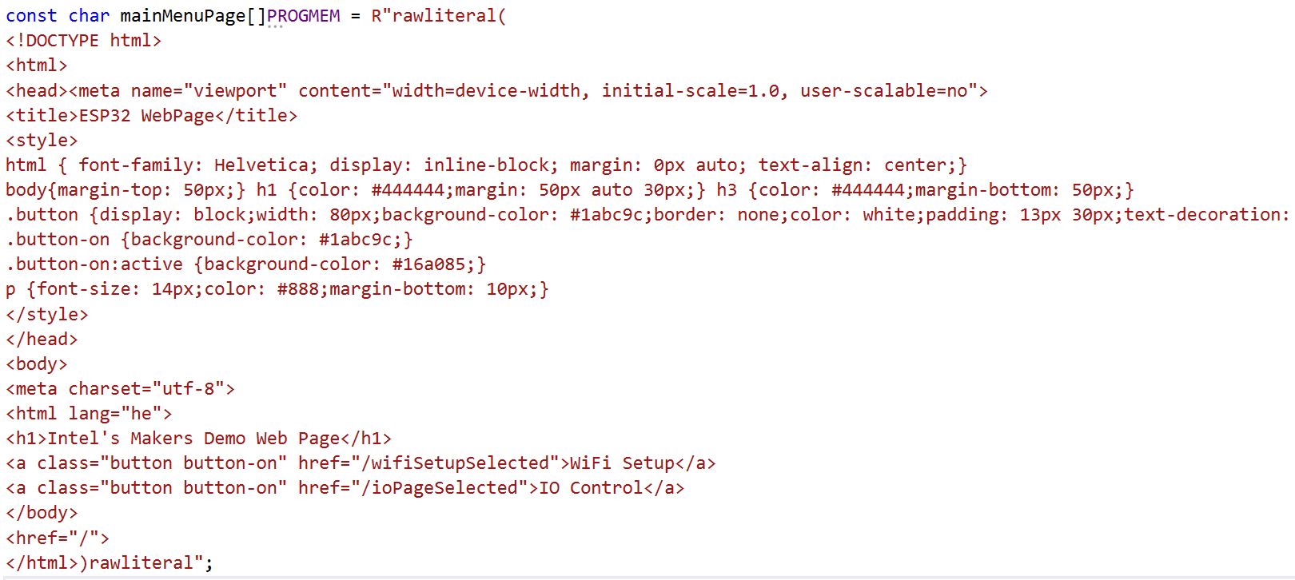
Webserver – html data

Slide 35
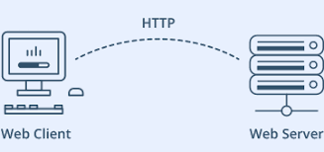
Webserver – html data
For static data with pre-defined start conditions:
const char mainMenuPage[]PROGMEM = R"rawliteral(
HTML Data
)rawliteral";
For dynamic data with interactive page we need to use String and build the page in real time!

Slide 36
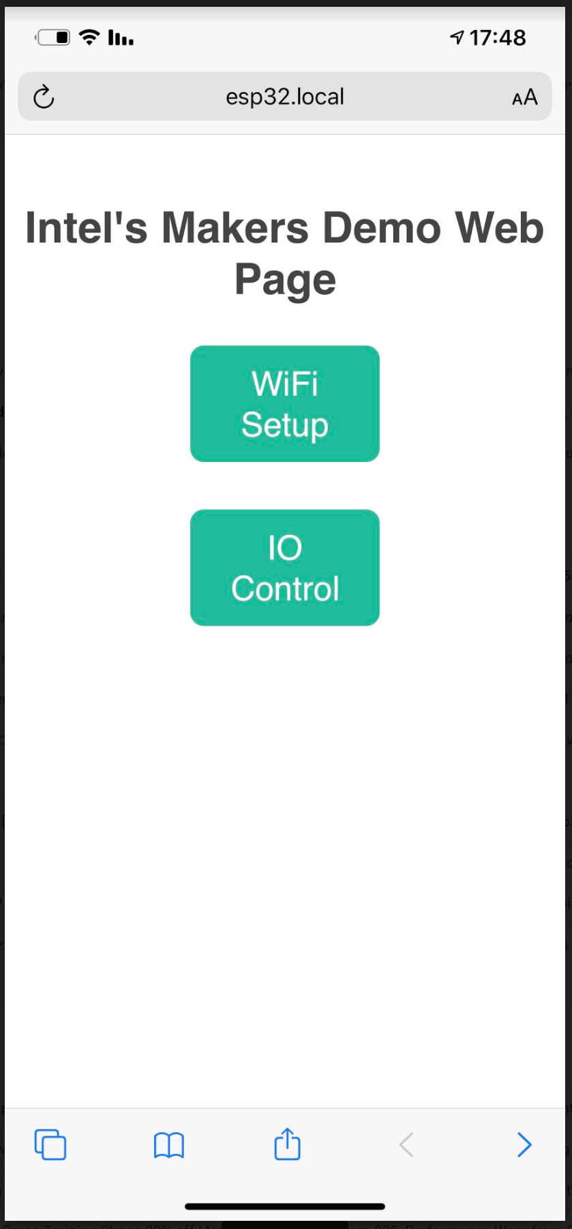
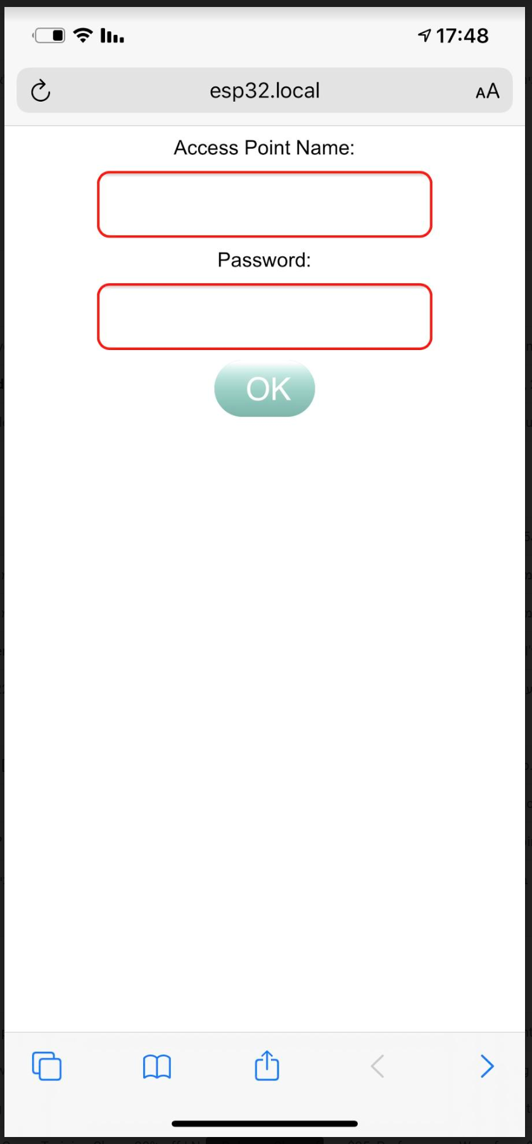
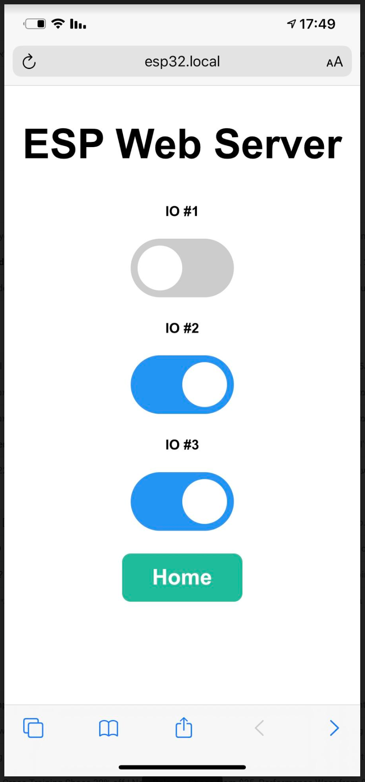
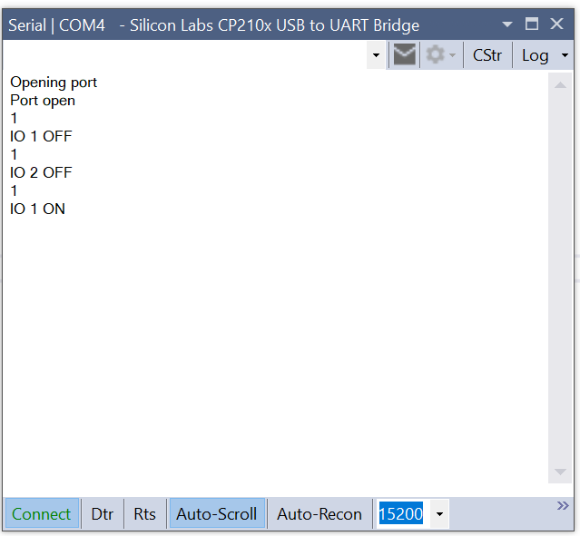
How does it looks like…

Slide 37
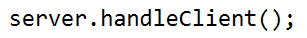
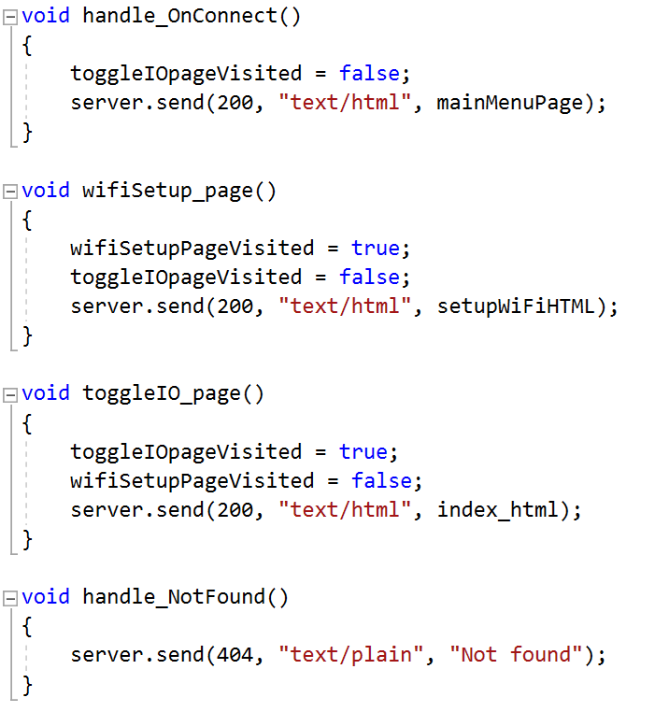
Webserver – handle the client

Slide 38
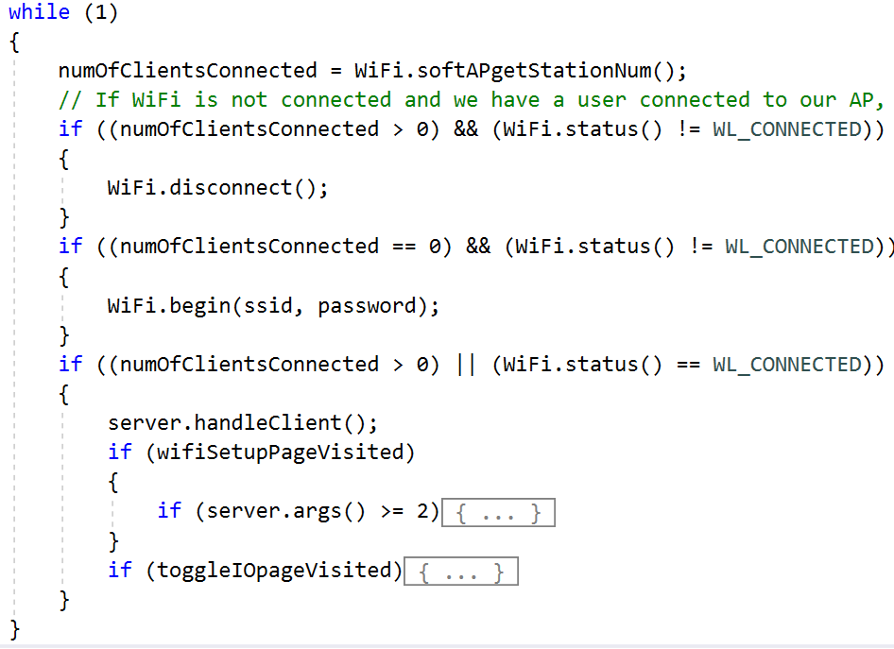
Webserver – processing incoming data

Slide 39
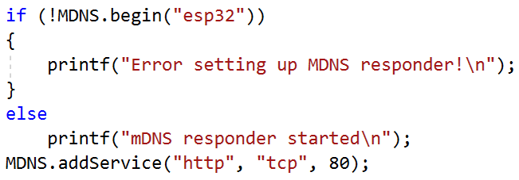
Multicast DNS
Domain Name System
MDNS – Is a zero-configuration service
Enables usage of names instead of IP address
Our ESP32 runs Multicast DNS (MDNS)
Windows and Apple devices can work with MDNS
Sadly Android does not ☹
Usage:
http://esp32.local/
No MDNS support - http://192.168.14.1/ (just an example IP)

Slide 40
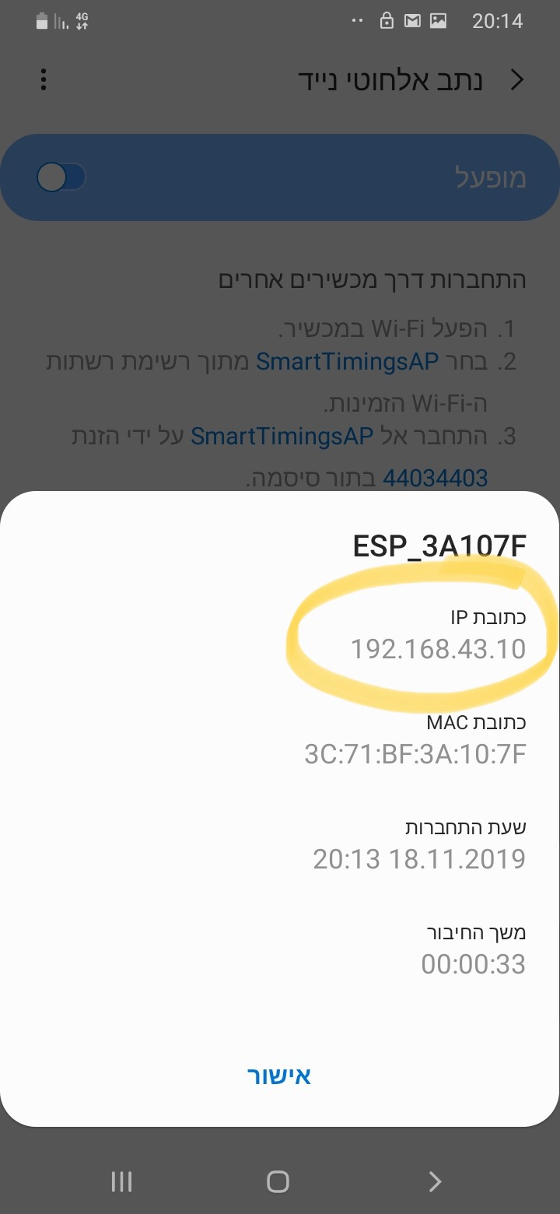
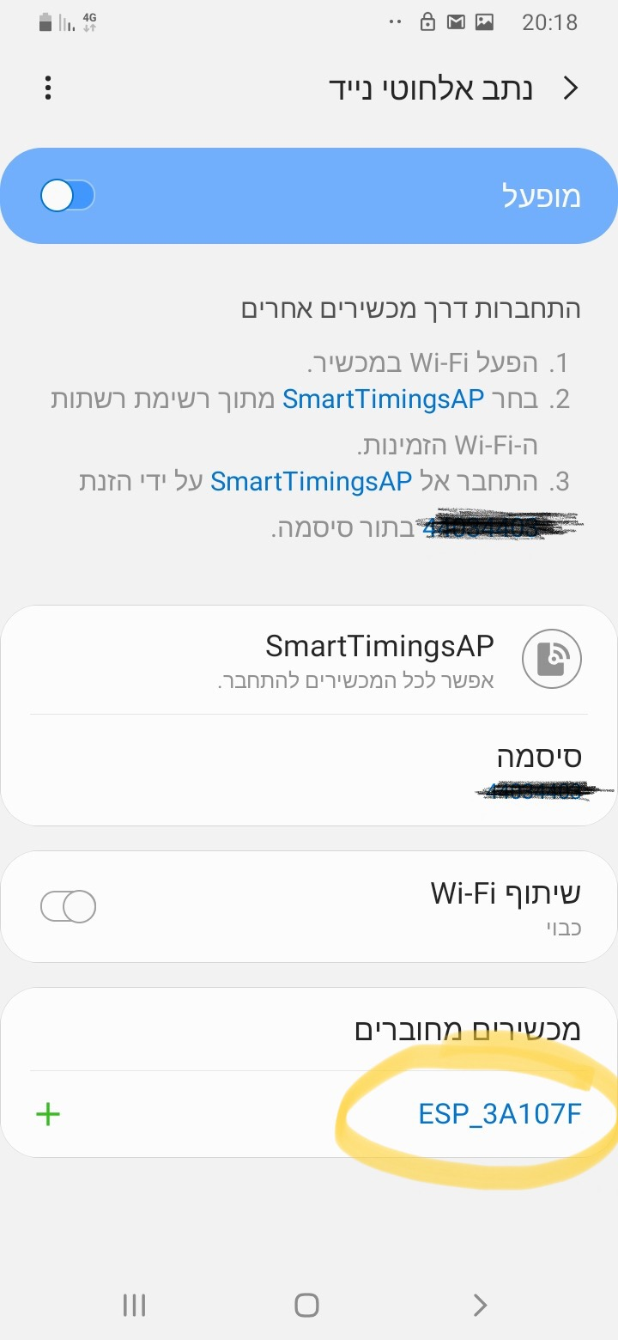
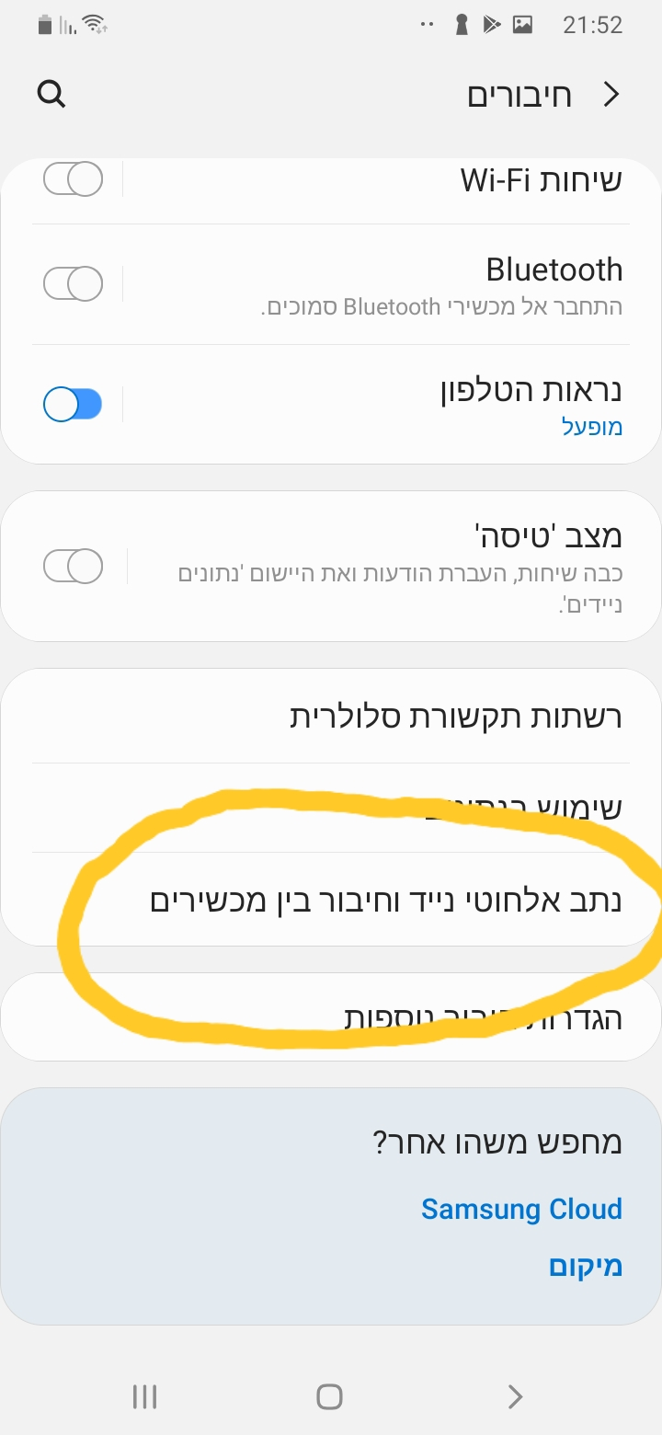
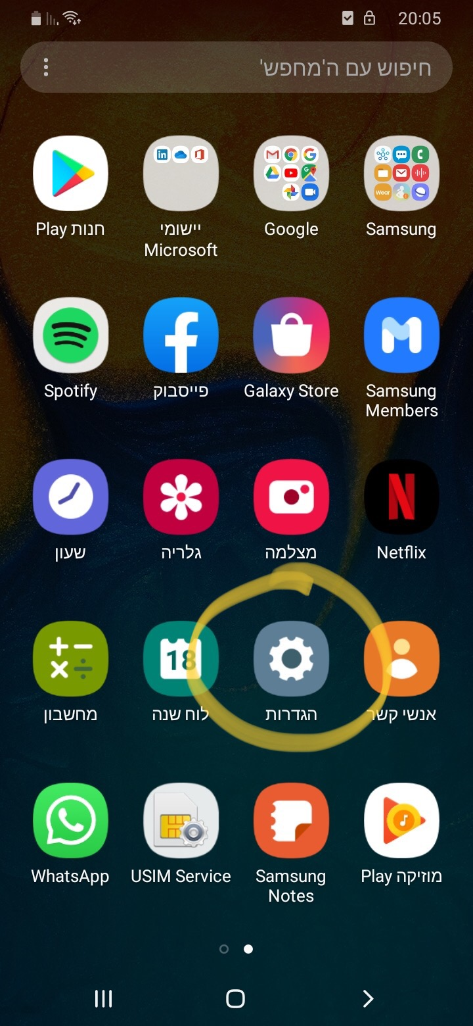
No mdns on Android so… (buy an iPhone ☺ or)

Slide 41

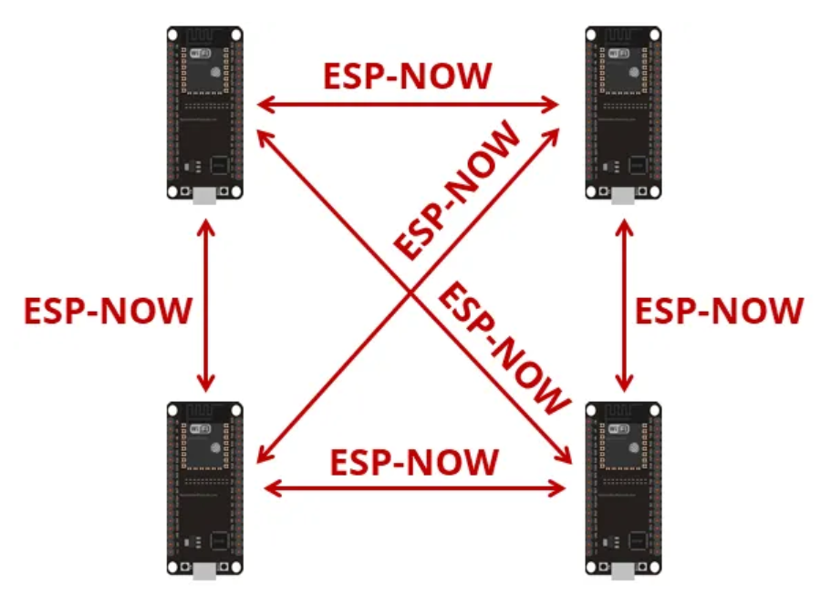
Protocol developed by Espressif
Enables multiple devices to communicate without using Wi-Fi
Low-power 2.4GHz wireless connectivity
Encrypted and unencrypted unicast communication
Up to 250-byte payload can be carried
10 encrypted peers at the most (STA mode), 6 for SoftAP or STA + SoftAP

Slide 42
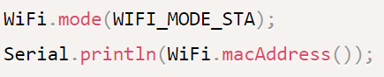




Esp-now
Works with MAC address
Need to know the our MAC and the Peer’s
Initialize the protocol
Register callback functions for send and receive
Register peers
Upon sending the send function will be called:
With status
With the MAC of the targeted peer
Upon receiving the receive function will be called:
With the MAC of the sender
With the received data

Slide 43

IOT – Controlling our ESP32 over the cloud
Using the ESP’s WIFI
We need to connect to a hotspot with internet access
We need a service provider to enable cloud activities such as
Control I/Os
Get and push data to our ESP
There are many cloud service providers out there
I prefer using Blynk (more on the next slide)

Slide 44
IOT – BLYNK
Works via application on a phone or tablet (No web or PC apps)
Can work via Wi-Fi or Bluetooth
The application is very easy to use and very powerful
Code is extremely simple to manipulate using a dedicated library
Has a code wizard generator on their website
Wi-Fi and Bluetooth code is the same, only small change in initialization
Automatic application sync for all used devices
Android supports widgets
We can use our own server!! (RPI4)
Blynk have a service to generate an application for us to be published on app store
Look at the course GIT for a user guide and a demo code

Slide 45


MQTT
Needs a broker (we can setup our own very cheap!)
ESP32 is the device
Works all over the world

Slide 46


LoRa
Long range 433-966 MHz point to point communication
Up to 5KM
Uses unique address (65K)
SPI interface to ESP32

Slide 47

Multi Tasks
Tasks and Multi CPU
TaskHandle_t Task1;
bool virtualPin1 = true, virtualPin2 = true;
void Task1code(void * pvParameters)
{
while (1)
{
virtualPin1 = true;
delay(1000);
virtualPin1 = false;
delay(1000);
}
}
// In Setup
xTaskCreatePinnedToCore(
Task1code, /* Task function. */
"Task1", /* name of task. */
1000, /* Stack size of task */
NULL, /* parameter of the task */
5, /* priority of the task */
&Task1, /* Task handle to keep track of created task */
0); /* pin task to core 0 */

Slide 48

Queues
Queue
QueueHandle_t vidQueue;
void Task(void *arg)
{
while (1)
{
xQueueReceive(vidQueue, &param, portMAX_DELAY);
….Code will run if we get message on the queue
}
}
// Sender Code
xQueueSend(vidQueue, &param, portMAX_DELAY);
// In setup
vidQueue = xQueueCreate(1, sizeof(uint32_t*));

Slide 49
Flash memory
Non volatile programable memory
Most common interface is SPI (1,4 or 8 bits)
Sector based (4KB, 8KB, 16KB, 64KB, 128KB) – ESP32’s flash sector size is 4KB
After erase the state of all erased bits is logic 1(0xFFFFFFFF)
We can set any bit to 0, but cannot set it back to 1 unless we erase a complete sector
Sector can be erased around 100000 times!! That’s all!!
Erase operation is long (~10ms)
Not suitable serving a memory for counters (will stop functioning after 100000 time!)
Sectors can be protected

Slide 50
EEprom memory
Small sizes (2KB to 64KB)
Size to price ratio is bad ☹
You can write to any byte any data
Most common interface is I2C
Very slow and mostly used for saving configuration data
ESP32’s EEPROM is emulated on the main flash and is occupying one sector (4KB)
How to use:
EEPROM.begin(512); // Size up to 4096
EEPROM.write(12/*Address*/,100/*Data*/);
EEPROM.commit(); // Save the data

Slide 51

ESP32 Flash memory Partitions
Partition table is flexible
Can be set through visual micro
Application partition 1
1.2MB
Application partition 2
1.2MB
SPIFFS
1.5MB

Slide 52


SPIFFS – SPI flash system
Resides on the ESP32’s flash memory
Create a data folder in the sketch folder
Upload it through visual micro
Files accessible in our code
Look @ ESP32_SPIFFSdemo.ino
Copy the data folder into sketch folder

Slide 53

File System - SPIFFS
void setup() { // Launch SPIFFS file system
if (!SPIFFS.begin())
{
Serial.println("An Error has occurred while mounting SPIFFS");
}
}
void loop() {
File file = SPIFFS.open("/TestFile.txt");
char buf[100];
int fileSize;
if (!file)
{
Serial.println("Failed to open file for reading");
while (1);
}
Serial.print("File size: ");
Serial.println(fileSize = file.size());
if (fileSize < 100)
{
file.readBytes(buf, fileSize);
for (size_t i = 0; i < fileSize; i++)
{
printf("%c", buf[i]);
}
printf("\n");
}
file.close();
while (1);}

Slide 54
File System – SD card over SPI
#include "FS.h"
#include "SD.h"
#include "PCF8574.h"
SPIClass SDspi(HSPI); // VSPI is used by LCD
bool SDmountOK;
PCF8574 pcf8574(0x21);
// the setup function runs once when you press reset or power the board
void setup() {
Serial.begin(115200);
pcf8574.begin();
pcf8574.pinMode(P0, OUTPUT); // SD CS
pcf8574.digitalWrite(P0, LOW); // Set SD card chip select to low (enabled)
SDspi.begin(15, 36, 13, -1);
if (!SD.begin(50, SDspi, 1000000, "/sd", 5))
{
printf("Failed to mount SD card!\n");
SDmountOK = false;
}
else
{
printf("SD card mounted on VSPI.\n");
SDmountOK = true;
}
}// the loop function runs over and over again until power down or reset
void loop() { if (SDmountOK)
{
listSDcardFiles("/");
}
while (1);}
FAT32 full support
Possible to load new code from SD!

Slide 55

OTA (Over the air update)
Possible to update the FW directly from
GIT
SD Card
Directly from a PC using Web Server code

Slide 56
Useful information
IOs
When using SPI RAM
DMA
You can expand the total malloc size to include the SRAM but the speed of SPI RAM allocated memory is much slower (use: heap_caps_malloc_extmem_enable(1024 * 1024 * N); N = number of MB needed)
Some IOs are used for sample @ reset, make sure to use them properly or your project might not work (info is specific to each member of the ESP32 family)
When WiFi is enabled analog inputs from channel 2 are not functional
S2\3 can perform DMA from SPI-RAM!
ESP32 has DMA (direct memory access) engines, they are implemented differently on S2\3
Don’t buy official ESP32 modules, look at AliExpress
M5 stack has very interesting modules
So as Lilygo
Visual studio can be used with Visual Micro plug-in (12$) for the best SDK experience out there!
There are lots of off the shelf modules in the market

Slide 57

GPIO2 - Strapping pin - will not load FW if pulled down
GPIO12 - Strapping pin - will not boot if pulled high
GPIO34-39 can only be set as input
ADC2 pins cannot be used when Wi-Fi is used

